Slide 1
ISOFY
Isomer identifying app

Slide 2

Freeform - May be drawn free hand

Slide 3
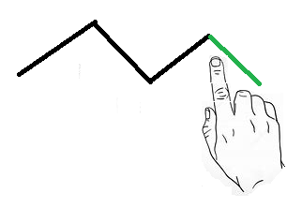
Build upon - Add bonds to a base molecule

Slide 4
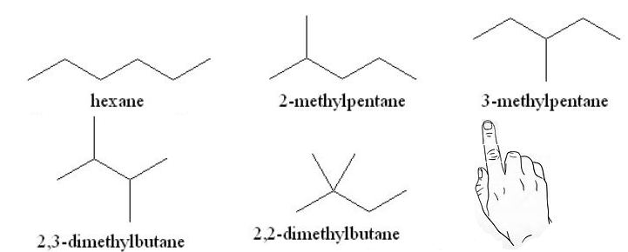
Direct - Select your choice from a finite list

Slide 5
Cons
Pros
Freeform
Intuitive to use
Novel interface
Build
Prevents ambiguous entries
Direct
Quickest to implement
Freeform
Most expensive
Build
Special UI
Direct
Breaks down as options increase
Dull UI

Slide 6
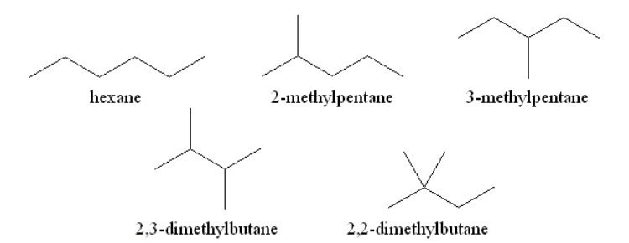
Hexane isomers
Initial release will allow
selection of the hexane
isomers

Slide 7
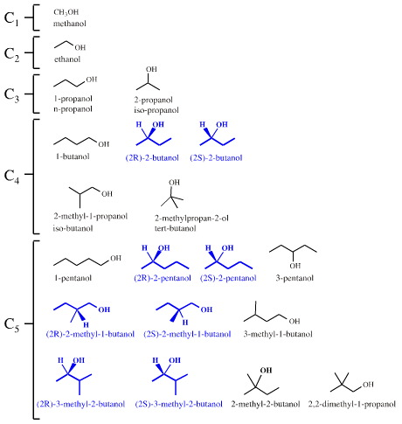
Organic isomers
Designed for growth. Other groups of iosmers can be added as needed.

Slide 8
User draws the chemical structure
The user can draw the chemical structure free hand and the app will select the structure from the database that most closely matches the user’s input.

Slide 9
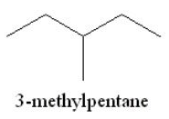

Modifications can be made
The user may modify if desired.

